Slide 1

Data Analysis to Protect Against Climate-Driven Extremes
Wuppertal, 29.10.2024

Slide 2
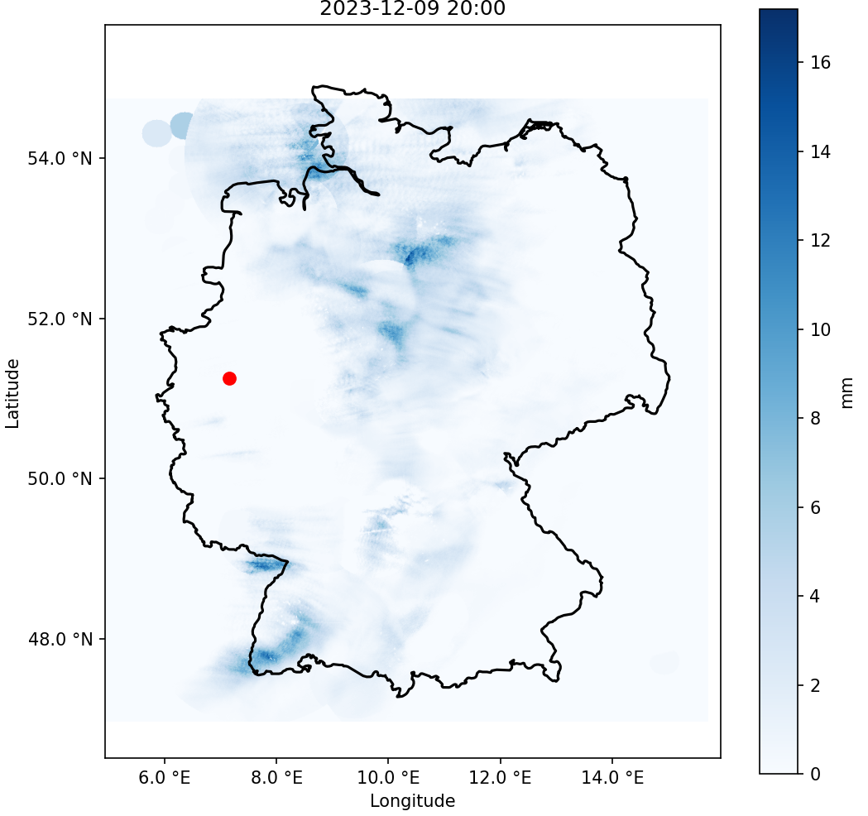




The Dataset
Preprocessed Precipitation Radar Data
Huge Dataset: 9GB compressed, 344GB uncomp.
Recording Interval: 10 minutes, hourly
Time Range:
2006
2023
18 years

Slide 3
An exemplary Animation

Slide 4



The next Steps of the Data Analysis
Long-term Climate Trends and seasonal Trends
Weather Extremes
Predicting extreme Weather Events

Slide 5
Step 1: Basics
Data Analysis
Long-term Climate Trends and Seasonal Trends
Changes in precipitation: has the average amount of precipitation increased or decreased over the entire period? Are there clear trends in certain seasons or months?
Change in precipitation intensity: Have heavy rainfall events become more frequent or more intense?
Shift in the rainy seasons: Have the typical rainy seasons shifted? Have they become longer or shorter?
Changes in precipitation patterns: Have spatial patterns in precipitation changed? Are there regions that receive more or less precipitation?

Slide 6
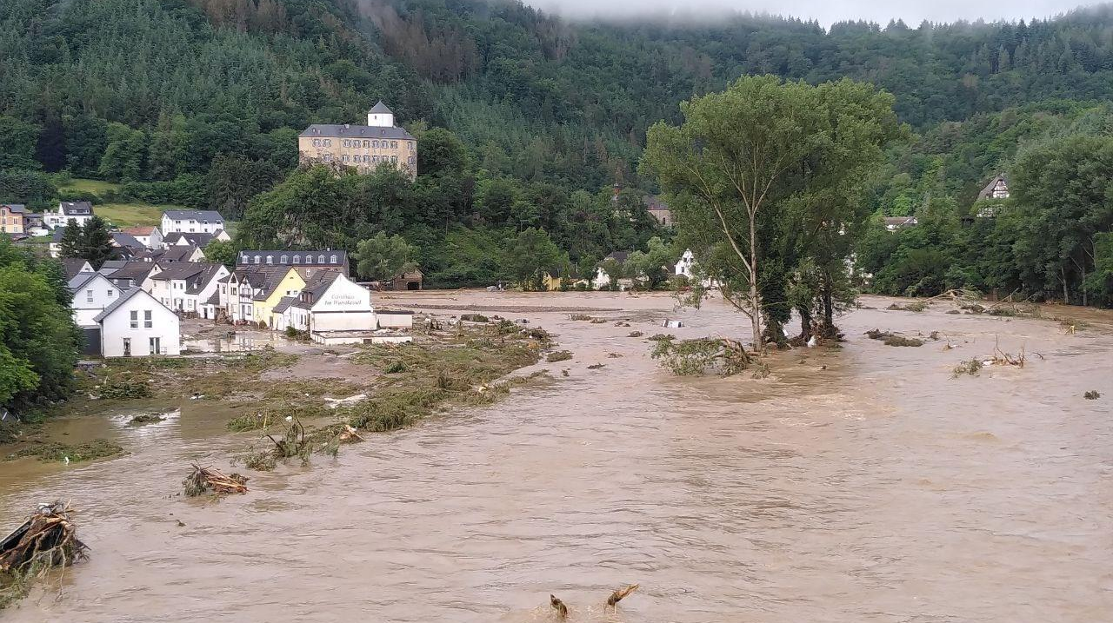
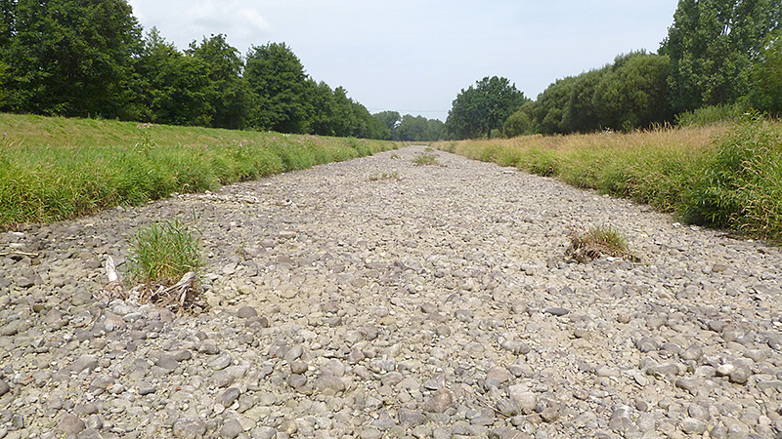
Step 2: Extremes
Data Analysis
Weather Extremes
Frequency and intensity of extreme events: How often did extreme precipitation events (e.g. heavy rain, droughts) occur? Did they become more intense?
Regional differences: Do extreme events occur more frequently in certain regions?
Flood in Altenahr-Kreuzberg, July 2021 Photo: Martin Seifert
The river “Dreisam” has completely dried up 3 kilometres west of Freiburg, August 2022 Photo: Till Meinrenken

Slide 7
Step 3: Predictions
Data Analysis
Predicting extreme Weather Events
Precipitation Patterns: Are there any patterns before an extreme weather event that could be used to predict it?
Early warning systems: Can an early warning system be built from precipitation data? Could the flood disaster of 2021 have been recognized earlier?

Slide 8

Data Analysis
Expected Challenges
Dataset size: parallel processing in chunks
Inhomogeneous data: different time intervals and incomplete radar coverage

Slide 9

Thank you for your attention

Slide 10

Bergische Universität Wuppertal Lehrstuhl für Technologien und Management der Digitalen Transformation Gebäude FZ (Technologiezentrum Wuppertal, W-tec) Lise-Meitner-Straße 27 42119 Wuppertal Telefon +49 202 439-1043 Postfach 42097 Wuppertal Internet www.tmdt.uni-wuppertal.de

